Slide 1
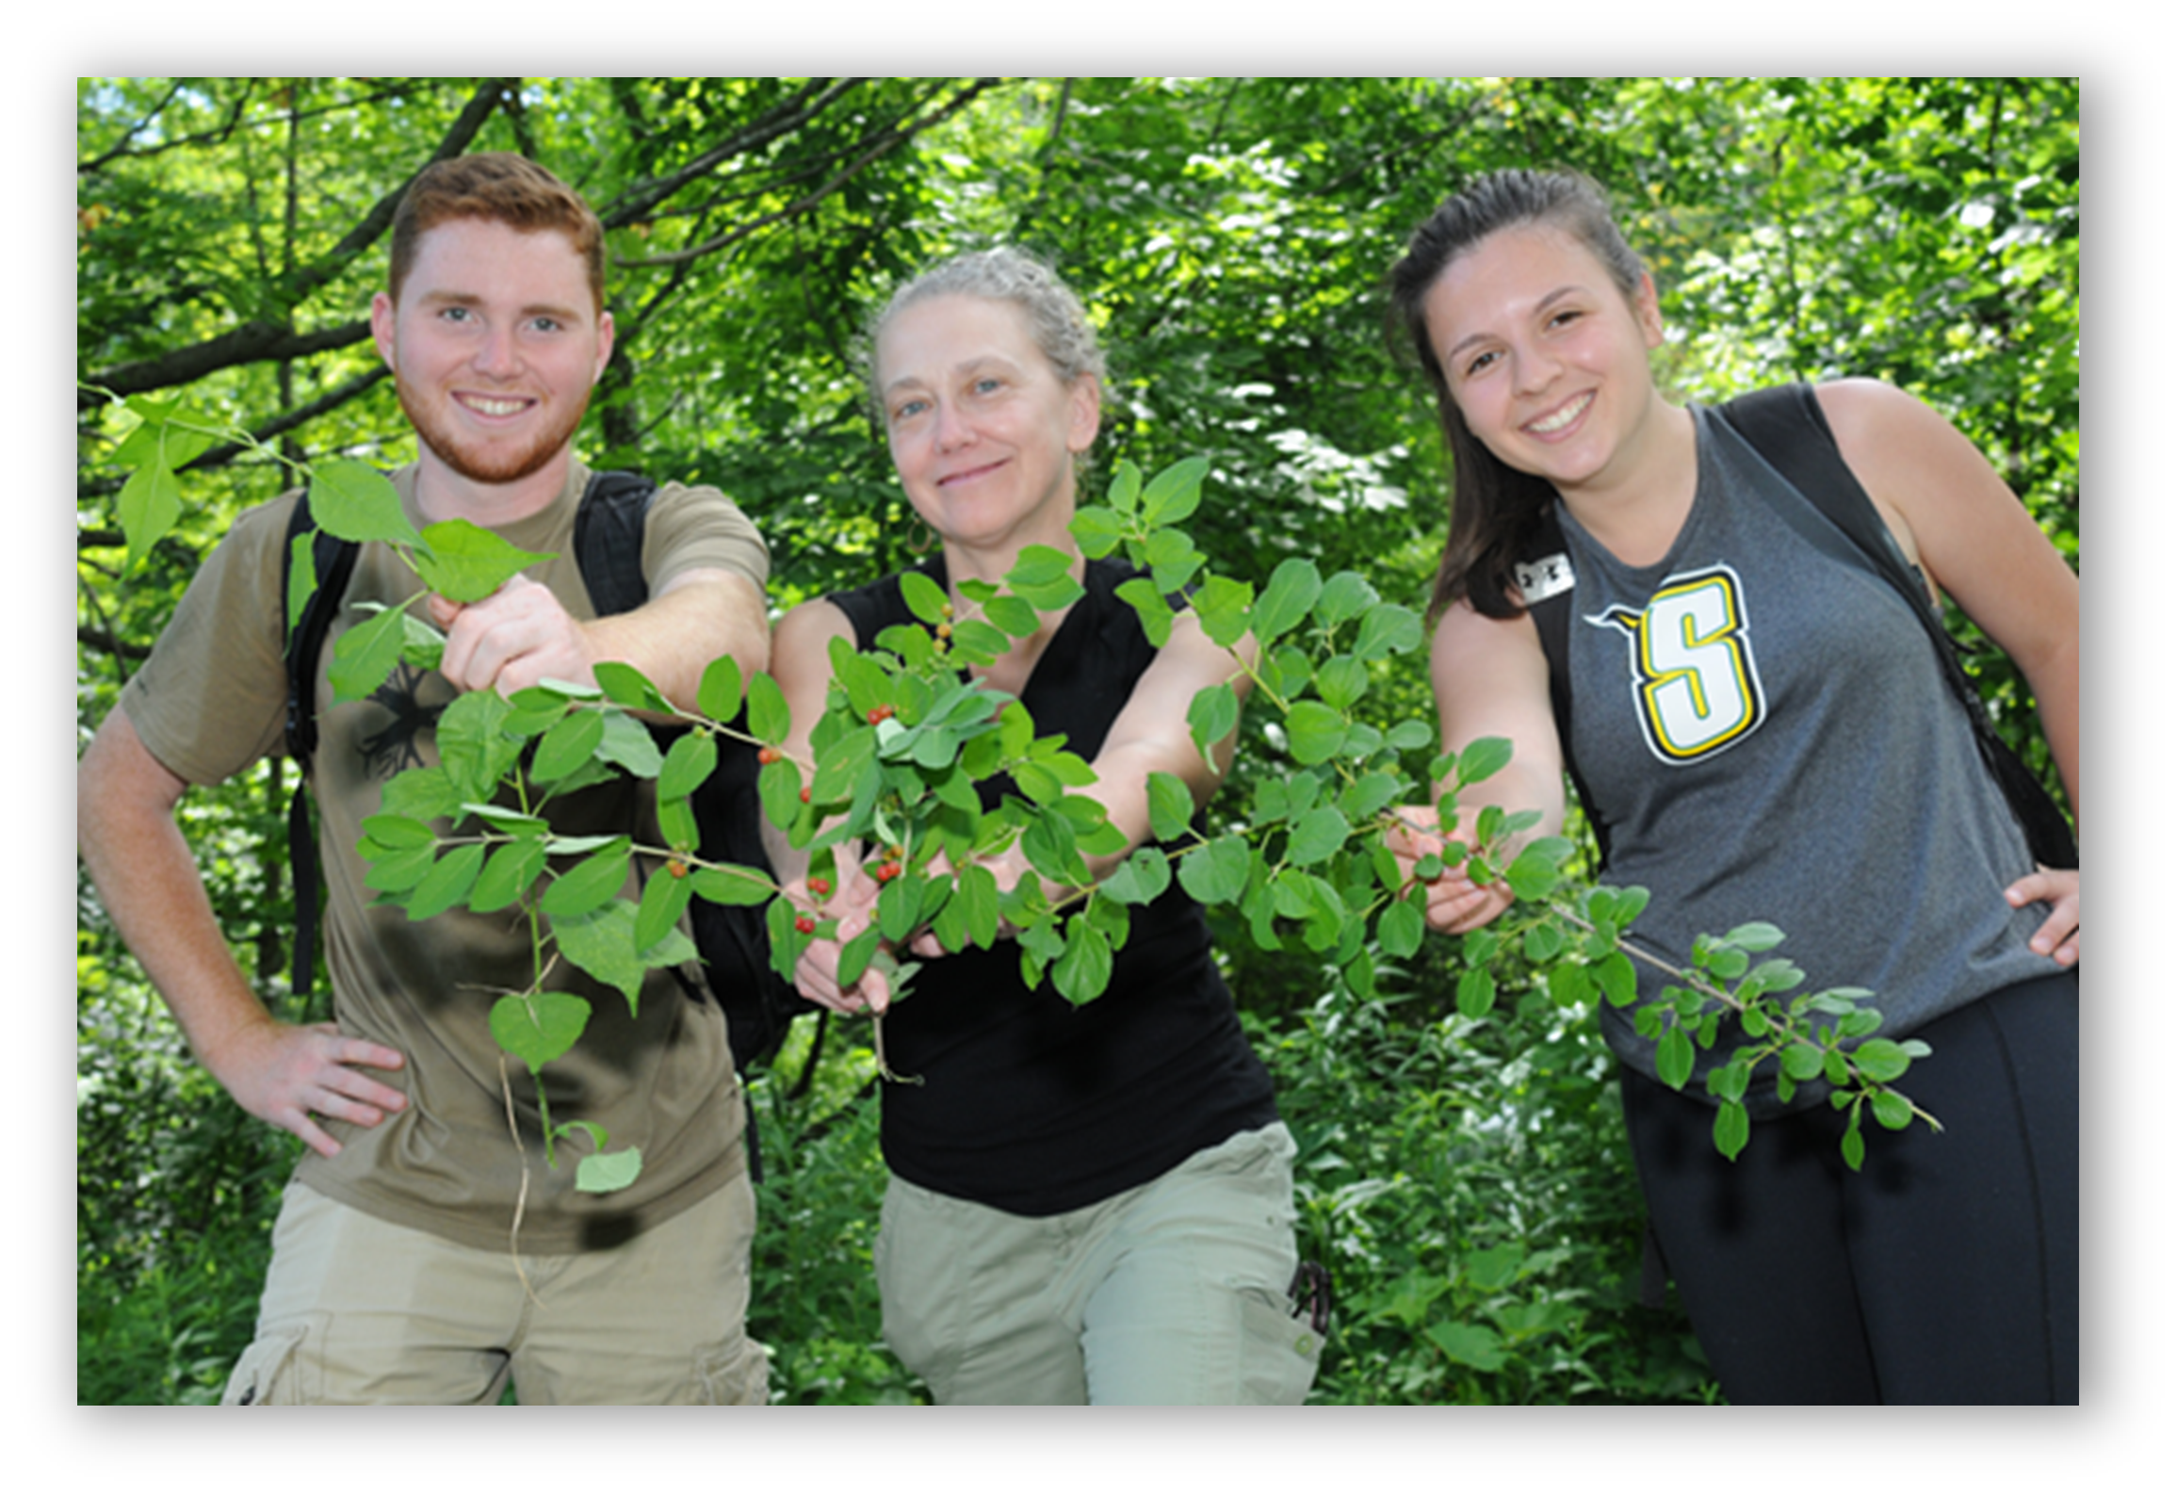

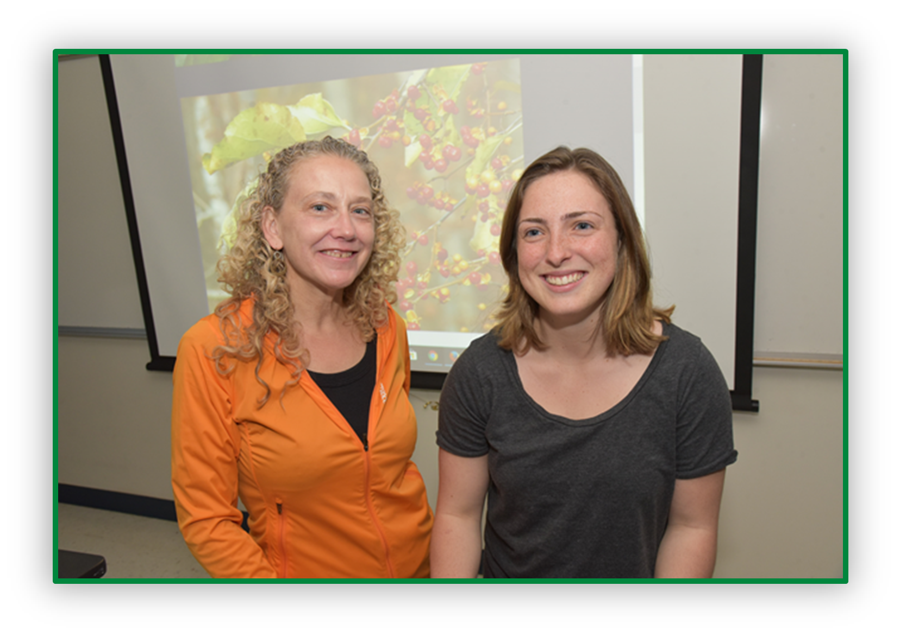

Identifying Priority Invasive Species Conservation Efforts in the Town of Colonie

Slide 2
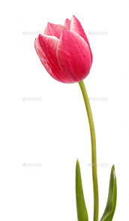
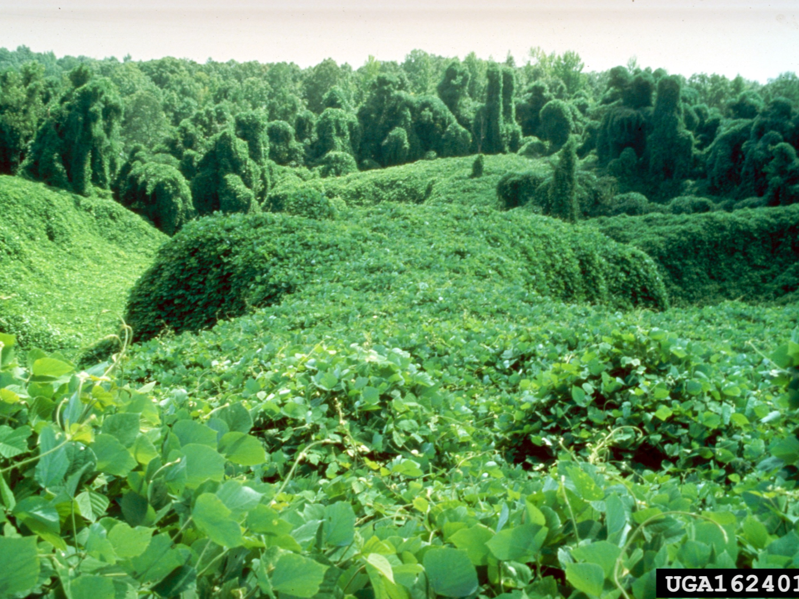
Background
A species that rapidly reproduces and displaces native species causing ecological and economic harm
Notes:
Invasive species are non-native plant, animals, and pathogens that cause harm to the environment, the economy, or human health
Invasive species are species that are not native to a given area or region.
These species tend to advance rather quickly and aggressively, which can be hard to manage and control.
Invasive species can outcompete native species, therefore decreasing abundance of native species, and can cause extreme harm to the environment and the economy.

Slide 3
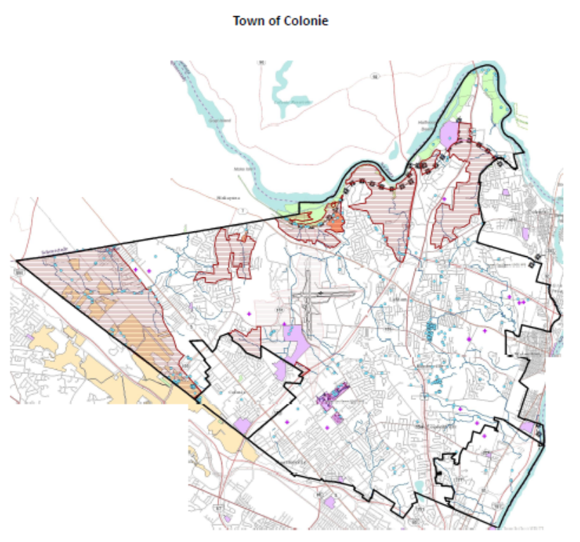
Sites Surveyed (2018)
Mohawk-Hudson Bike Trail (Town of Colonie section)
The Crossings
Unnamed property with stream
Schuyler Flatts Cultural Park
Town of Colonie Golf Course
Additional Site:
Siena College campus
Notes:
Mohawk-Hudson Bike Trail (Town of Colonie section)
The Crossings
Unnamed property with stream (newly acquired property; located within a conservation overlay district)
Schuyler Flatts Cultural Park
Town of Colonie Golf Course
Also, Siena Campus

Slide 4
Sites Surveyed (2019)
Maywood Pocket Park
Lishakill Pocket Park
West Albany Pocket Park
Allegheny Pocket Park
Latham Kiwanis Pocket Park
Stanford Heights Pocket Park
Fox Preserve
Ashford Glen Preserve
Ann Lee Pond
Shaker Heritage Site
Boght Baseball Complex
North Colonie Sports Complex
Lisha Kill Sports Complex
Town of Colonie Park Boat Launch
Newtonville Community Park
Notes:
Mohawk-Hudson Bike Trail (Town of Colonie section)
The Crossings
Unnamed property with stream (newly acquired property; located within a conservation overlay district)
Schuyler Flatts Cultural Park
Town of Colonie Golf Course
Also, Siena Campus

Slide 5
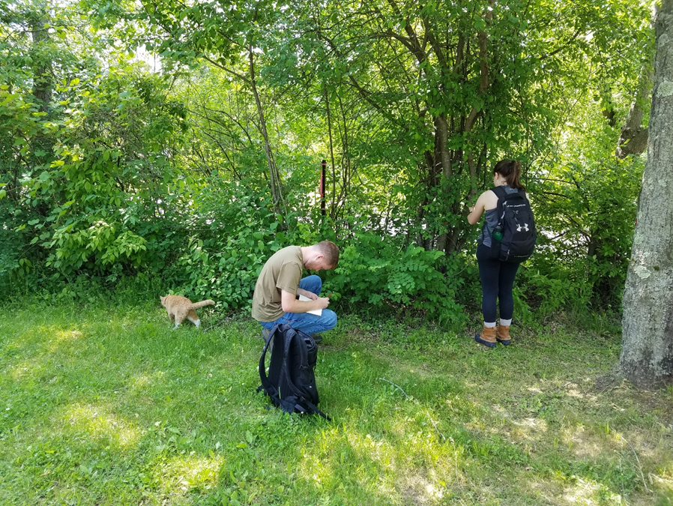
Mapping Protocols
Terrestrial sites
Surveyed in June 2018; May – June 2019
Walked potential corridors for invasion
  Roads, paths, streams, edges
Mapped locations of species encountered
  iMapInvasives
  Regular intervals; relative abundance
Aquatic sites
Surveyed in mid-June
Rake toss (13” garden rake attached to 10’ of rope); every 3-5 meters (shoreline)
Notes:
We developed and field-tested aquatic invasive plant surveys. We sampled using a rake toss (13” garden rake end attached 10 feet of rope). Rake was tossed out into the water and pulled back to shore. Invasive species caught in the rake tines were identified, recorded, and documented in iMapInvasives. Sample points were spaced roughly 3-5 meters apart. Aquatic surveying was done in mid-June.All field surveys were completed. For each site, areas that are potential corridors for invasion (e.g., roads, paths, streams, edges) were surveyed for invasive species. Locations of invasive species encountered (and rough information on their relative abundance) was recorded and uploaded to iMapInvasives. Locations were mapped at regular intervals so that we could get an indication of how widespread each species was across a given site.

Slide 6
2018

Slide 7
2018

Slide 8
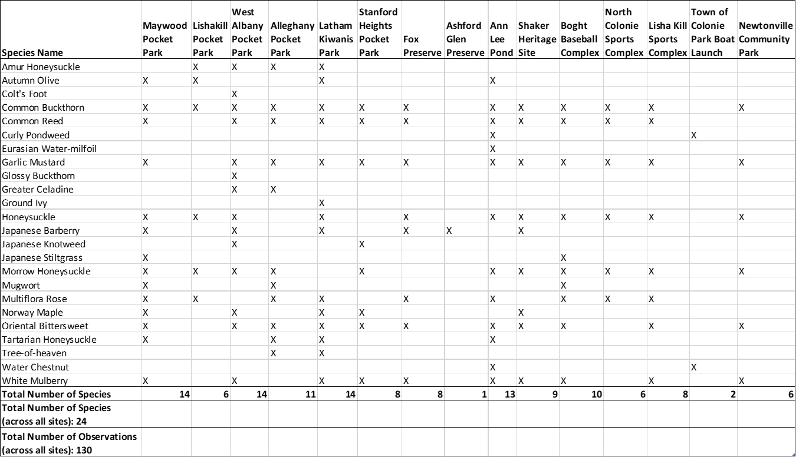


2019
Notes:
The most widespread and abundant terrestrial invasive species encountered were: Oriental Bittersweet (Celastrus orbiculatus), Honeysuckle (Lonicera spp.), Common Buckthorn (Rhamnus cathartica), and Garlic Mustard (Alliaria petiolata). These species were found at nearly all the terrestrial sites and in high abundance (Tables 1‐16). Species that were found at more than half of the terrestrial sites and in moderately‐high abundance included: Common Reed (Phragmites australis), White Mulberry (Morus alba), and Multiflora Rose (Rosa multiflora). Species that were found at less than half the sites, but were moderately to highly abundant where they were found, included: Japanese Barberry (Berberis thunbergii), Norway Maple (Acer platanoides), and Japanese Knotweed (Reynoutria japonica). Rounding out the most commonly encountered include Autumn Olive (Elaeagnus umbellata) and Mugwort (Artemisia vulgaris var. vulgaris); these species were found at less than half the sites, but were moderately abundant where they occurred. Other species we encountered included Tree-of-Heaven (Ailanthus altissima), Greater Celandine (Chelidonium majus), and Colt’s Foot (Tussilago farfara).

Slide 9


2019
Notes:
The most widespread and abundant terrestrial invasive species encountered were: Oriental Bittersweet (Celastrus orbiculatus), Honeysuckle (Lonicera spp.), Common Buckthorn (Rhamnus cathartica), and Garlic Mustard (Alliaria petiolata). These species were found at nearly all the terrestrial sites and in high abundance (Tables 1‐16). Species that were found at more than half of the terrestrial sites and in moderately‐high abundance included: Common Reed (Phragmites australis), White Mulberry (Morus alba), and Multiflora Rose (Rosa multiflora). Species that were found at less than half the sites, but were moderately to highly abundant where they were found, included: Japanese Barberry (Berberis thunbergii), Norway Maple (Acer platanoides), and Japanese Knotweed (Reynoutria japonica). Rounding out the most commonly encountered include Autumn Olive (Elaeagnus umbellata) and Mugwort (Artemisia vulgaris var. vulgaris); these species were found at less than half the sites, but were moderately abundant where they occurred. Other species we encountered included Tree-of-Heaven (Ailanthus altissima), Greater Celandine (Chelidonium majus), and Colt’s Foot (Tussilago farfara).

Slide 10
2019
Notes:
The most widespread and abundant terrestrial invasive species encountered were: Oriental Bittersweet (Celastrus orbiculatus), Honeysuckle (Lonicera spp.), Common Buckthorn (Rhamnus cathartica), and Garlic Mustard (Alliaria petiolata). These species were found at nearly all the terrestrial sites and in high abundance (Tables 1‐16). Species that were found at more than half of the terrestrial sites and in moderately‐high abundance included: Common Reed (Phragmites australis), White Mulberry (Morus alba), and Multiflora Rose (Rosa multiflora). Species that were found at less than half the sites, but were moderately to highly abundant where they were found, included: Japanese Barberry (Berberis thunbergii), Norway Maple (Acer platanoides), and Japanese Knotweed (Reynoutria japonica). Rounding out the most commonly encountered include Autumn Olive (Elaeagnus umbellata) and Mugwort (Artemisia vulgaris var. vulgaris); these species were found at less than half the sites, but were moderately abundant where they occurred. Other species we encountered included Tree-of-Heaven (Ailanthus altissima), Greater Celandine (Chelidonium majus), and Colt’s Foot (Tussilago farfara).

Slide 11
2019
Notes:
The most widespread and abundant terrestrial invasive species encountered were: Oriental Bittersweet (Celastrus orbiculatus), Honeysuckle (Lonicera spp.), Common Buckthorn (Rhamnus cathartica), and Garlic Mustard (Alliaria petiolata). These species were found at nearly all the terrestrial sites and in high abundance (Tables 1‐16). Species that were found at more than half of the terrestrial sites and in moderately‐high abundance included: Common Reed (Phragmites australis), White Mulberry (Morus alba), and Multiflora Rose (Rosa multiflora). Species that were found at less than half the sites, but were moderately to highly abundant where they were found, included: Japanese Barberry (Berberis thunbergii), Norway Maple (Acer platanoides), and Japanese Knotweed (Reynoutria japonica). Rounding out the most commonly encountered include Autumn Olive (Elaeagnus umbellata) and Mugwort (Artemisia vulgaris var. vulgaris); these species were found at less than half the sites, but were moderately abundant where they occurred. Other species we encountered included Tree-of-Heaven (Ailanthus altissima), Greater Celandine (Chelidonium majus), and Colt’s Foot (Tussilago farfara).

Slide 12
2019
Notes:
The most widespread and abundant terrestrial invasive species encountered were: Oriental Bittersweet (Celastrus orbiculatus), Honeysuckle (Lonicera spp.), Common Buckthorn (Rhamnus cathartica), and Garlic Mustard (Alliaria petiolata). These species were found at nearly all the terrestrial sites and in high abundance (Tables 1‐16). Species that were found at more than half of the terrestrial sites and in moderately‐high abundance included: Common Reed (Phragmites australis), White Mulberry (Morus alba), and Multiflora Rose (Rosa multiflora). Species that were found at less than half the sites, but were moderately to highly abundant where they were found, included: Japanese Barberry (Berberis thunbergii), Norway Maple (Acer platanoides), and Japanese Knotweed (Reynoutria japonica). Rounding out the most commonly encountered include Autumn Olive (Elaeagnus umbellata) and Mugwort (Artemisia vulgaris var. vulgaris); these species were found at less than half the sites, but were moderately abundant where they occurred. Other species we encountered included Tree-of-Heaven (Ailanthus altissima), Greater Celandine (Chelidonium majus), and Colt’s Foot (Tussilago farfara).

Slide 13
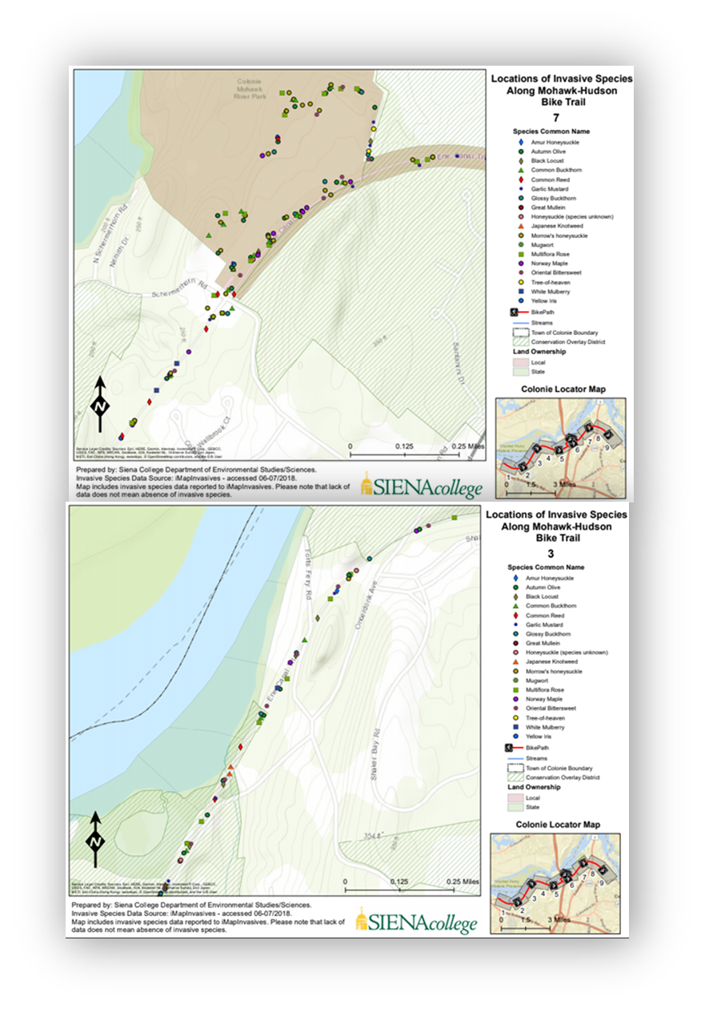

Slide 14
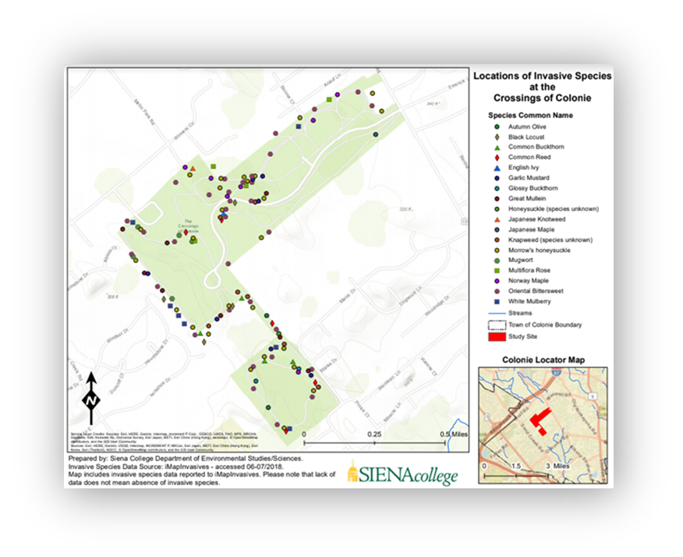

Slide 15
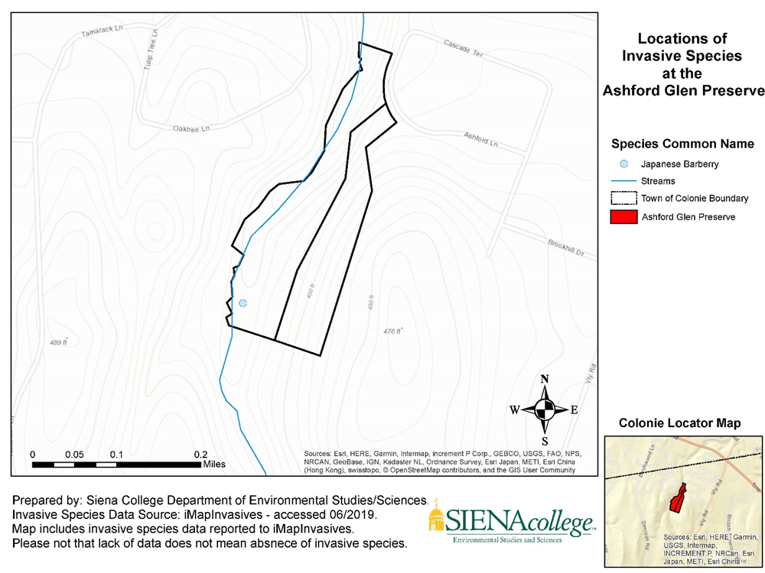
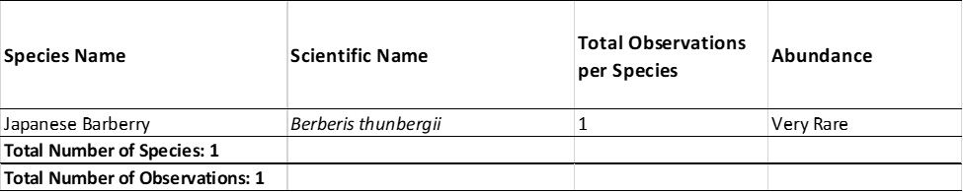
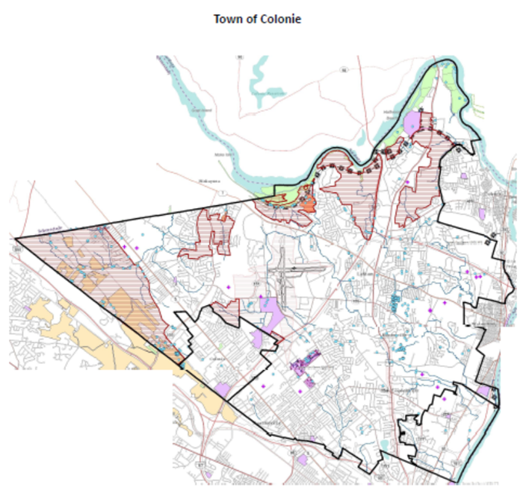
Sites of High Conservation Potential
Ashford Glen Preserve
Notes:
Ann Lee Pond is property managed by Albany County. The pond is choked with aquatic invasive species, which interferes with public recreational opportunities. Terrestrial invasive species are also abundant, especially along grass roadways and openings surrounding the pond (Table 9). However, there is a large forested area south and east of the main pond that has several hiking trails. Although these paths show use from hiking and mountain biking, it appears there is much less use than the area immediately surrounding the pond. We surveyed those trails, but found no invasive species.

Slide 16
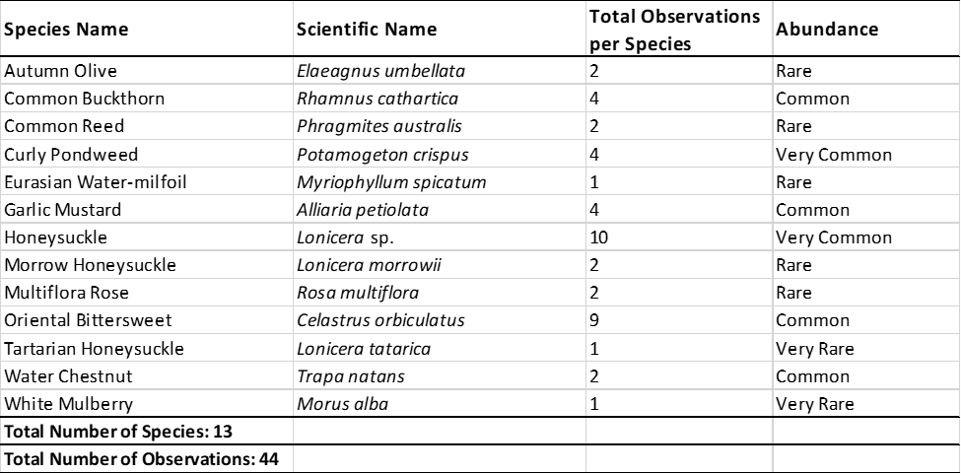
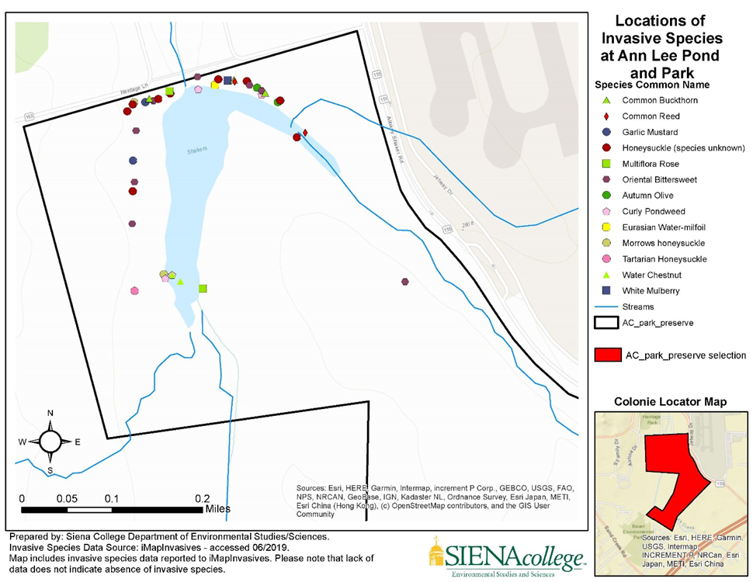
Sites of High Conservation Potential
Ann Lee Pond
Notes:
Ann Lee Pond is property managed by Albany County. The pond is choked with aquatic invasive species, which interferes with public recreational opportunities. Terrestrial invasive species are also abundant, especially along grass roadways and openings surrounding the pond (Table 9). However, there is a large forested area south and east of the main pond that has several hiking trails. Although these paths show use from hiking and mountain biking, it appears there is much less use than the area immediately surrounding the pond. We surveyed those trails, but found no invasive species.

Slide 17
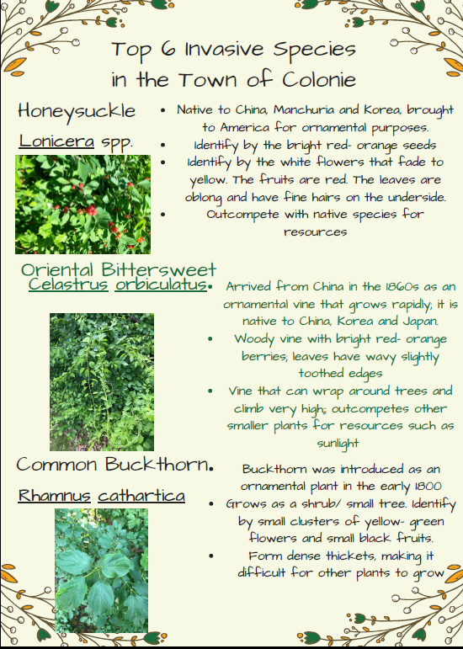
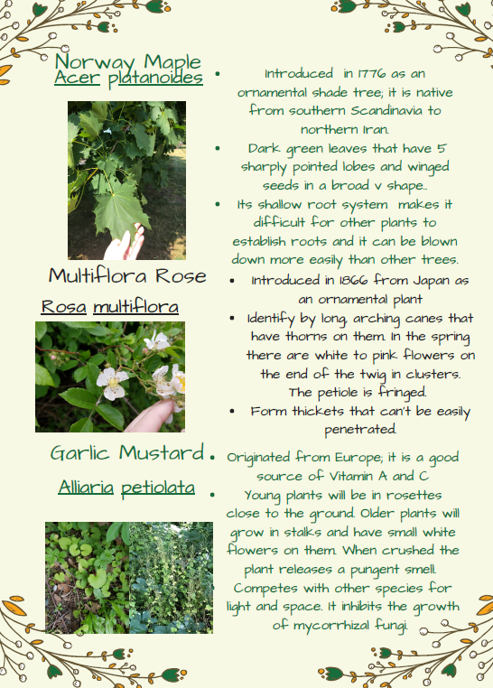
Public Outreach – Products
Top 6 Invasive Species (postcard size)

Slide 18
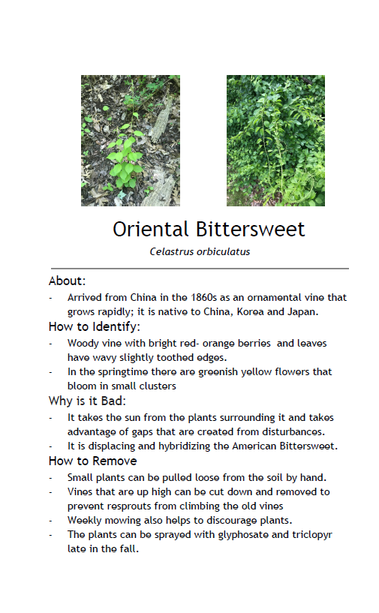
Products
Top 10 Invasive Species Booklet (adding two more)
Oriental bittersweet
Honeysuckle
Common buckthorn
Norway Maple
Multiflora Rose
Garlic mustard
Japanese knotweed
Phragmites
White mulberry
Adirondack Sports and Fitness (mountain bike article)

Slide 19


