Slide 1
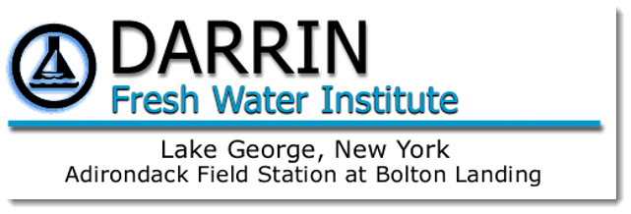
Aquatic Vegetation of Ballston Lake, New York
Prepared By
Lawrence Eichler, Research Scientist
Prepared for
Ballston Lake Improvement Association & The Capital-Mohawk Partnership for Regional Invasive Species Management (PRISM)

Slide 2
Ballston Lake, Saratoga County, NY

Slide 3
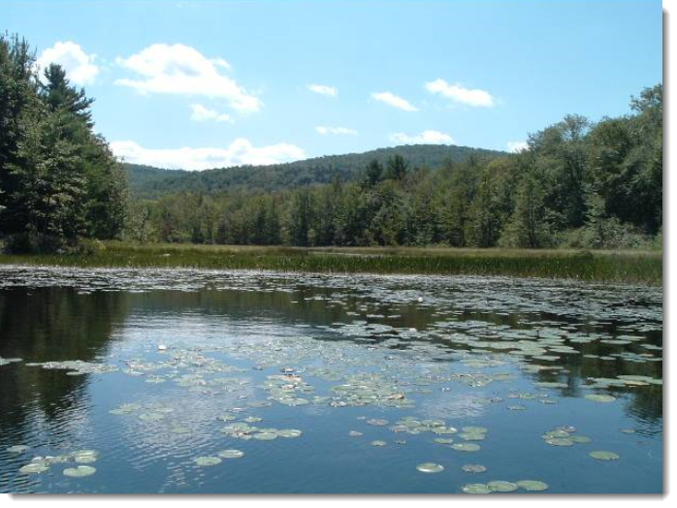
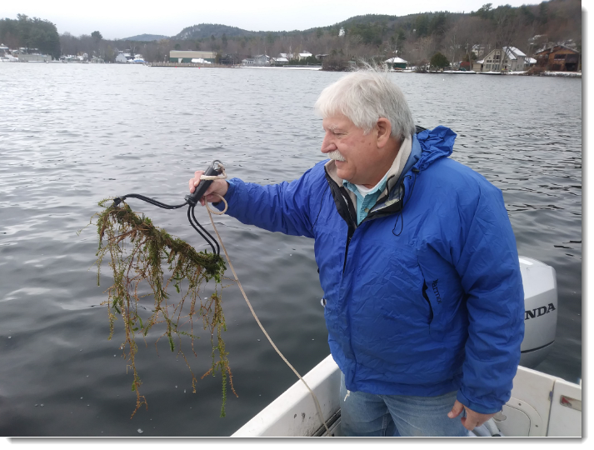
Sampling

Slide 4
Map of Ballston Lake with point intercept survey locations

Slide 5
Percent Frequency of Occurrence Ballston Lake, August 2019
1.
2.
3.
Invasive Species

Slide 6
1. Distribution of Coontail

Slide 7
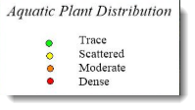
2. Distribution of Eurasion watermilfoil

Slide 8
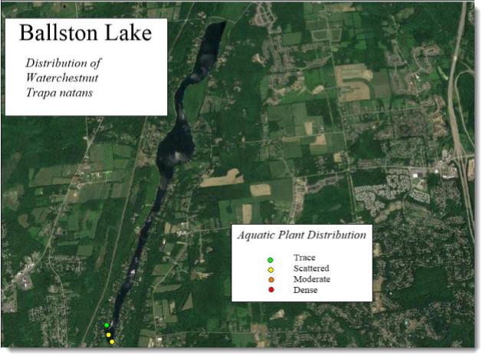
3. Distribution of Waterchestnut

Slide 9
Public Outreach – Boat ramp sign

Slide 10
Public Outreach - Flyer

Slide 11
Public Outreach – Lake Bulletin

Slide 12
Conclusions

