Slide 1
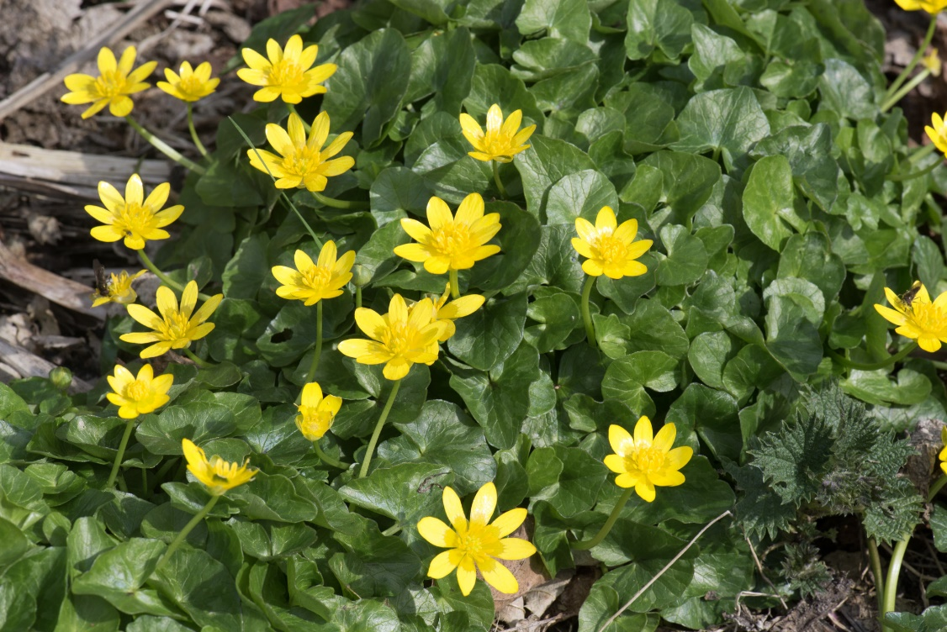
Lesser Celandine Management at Ann Lee Pond Nature and Historic Preserve

Slide 2
Dedicated as a county preserve in 1978
180-acre urban oasis includes a large pond, wetlands, forest and meadows.
Abundance native plants.
More than 80 species of birds have been observed at the pond and in surrounding areas.
Other wildlife include beaver, chipmunks, muskrat, coyote, fisher and deer and a variety or amphibians, reptiles and fish.

Slide 3
Lesser Celandine first reported in the preserve 2019
Proposal submitted to PRISM in 2021 to remove areas of infestation by treating them with herbicide
Proposal submitted 2022 to repeat treatment

Slide 5
Invasive Species Education

